Slide 1


Mohammad Hasnen Sheikh
18 September 2024

Slide 2

Outline
Executive Summary
Introduction
Methodology
Results
Conclusion
Appendix

Slide 3
Executive Summary
This report presents an analysis of SpaceX Falcon9 launch, we aimed to find out whether SpaceX Falcon9 can recover the first stage or not. We will also determine if SpaceX will reuse the first stage. Using a dataset of SpaceX, we employed various data science techniques, including data cleaning, exploratory data analysis (EDA), feature engineering, and machine learning models.
KEY FINDING:
Success Rate: Success rate of SpaceX Falcon9 is 67%.
ML Model: We created Decision Tree Classifier and other models to predict if the first stage land.
Predictive Model Performance: A Decision Tree Classifier achieved the best performance, with an accuracy of 83.33%.

Slide 4
Introduction
SpaceX advertises Falcon 9 rocket launches on its website with a cost of 62 million dollars; other providers cost upwards of 165 million dollars each, much of the savings is because SpaceX can reuse the first stage. Therefore, if we can determine if the first stage will land, we can determine the cost of a launch. Spaces X’s Falcon 9 launch like regular rockets. Unlike other rocket providers, SpaceX's Falcon 9 Can recover the first stage. Sometimes the first stage does not land. Sometimes it will crash. Other times, Space X will sacrifice the first stage due to the mission parameters like payload, orbit, and customer. Space Y that would like to compete with SpaceX founded by Billionaire industrialist Allon Musk. Your job is to determine the price of each launch. We will do this by gathering information about Space X and creating dashboards for our team. We will also determine if SpaceX will reuse the first stage. Instead of using rocket science to determine if the first stage will land successfully, you will train a machine learning model and use public information to predict if SpaceX will reuse the first stage.
Problems We have to solve are:-
Web Scrapping Falcon9 and Falcon Heavy Launches Records
Data Wrangling, Data Cleaning, and Exploring and Preparing Data
Launch Sites Locations Analysis with Folium
Space X Falcon 9 First Stage Landing Prediction

Slide 5

Section 1

Slide 6
Methodology
Executive Summary
Data collection methodology:
Used Python BeautifulSoup to extract data from Wikipedia Website
Perform data wrangling
Used Python Pandas to convert raw data into useable data
Perform exploratory data analysis (EDA) using visualization and SQL
Perform interactive visual analytics using Folium and Plotly Dash
Perform predictive analysis using classification models
Convert data into Numpy array, Standardize the data, and used train_test_split function to split data into training and testing set.
Found the best parameters for the models using Grid Search CV.
Create different model like Logistic Regression, SVM, Decision Tree Classifier to see which model fit the best.

Slide 7
Data Collection
The data was collected from various sources. They are:-
Data was collected from SpaceX API which is in json format so we also convert it to csv file
Another data set was collected from Wikipedia official website using web scrapping
SpaceX API
(.Json)
Request.get(“API”)
Raw Data
(CSV)
Wikipedia Website
(HTML)
Beautiful Soup
Raw Data
(CSV)

Slide 8
Data Collection – SpaceX API
We first gather data from SpaceX API, This API is available for everyone. We used request function to retrieve data from api and used json normalization to convert json to csv format.
Click For GITHUB Link
SpaceX API
(Json)
Request.get(API)
Json normalization
Raw Data
(CSV)

Slide 9
Data Collection - Scraping
We also gather another dataset from Wikipedia website. We get Wikipedia url and parse it to request.get() function then, We used web scrapping to scrap falcon 9 data using Beautifulsoup. We create a Soup object and convert html data to csv.
Click For GITHUB Link
Wikipedia Website URL
(HTML)
Request.get(URL)
BeautifulSoup Object
Raw Data
(CSV)

Slide 10
Data Wrangling
Load Data
Since we get Raw data we try to find some useful insights from it. We identify columns null value percentage and data types. We calculate no. of launches on each site, no. and occurrence of each orbit, no. and occurrence of mission outcome of orbit, and then we create a new clean dataset which have landing outcome label from Outcome column.
Click For GITHUB Link
Identify Null Values Percentage and Columns Data Types
Calculate no. of launches on each site
Calculate no. & occurrence of each orbit
Create Landing Outcome Label from Outcome Column

Slide 11
EDA with Data Visualization
We used the following Plots:-
Catplot is used to show relation between FlightNumber and Payload Mass
Scatter Plot is used to show relation between FlightNumber and Launch Site and many other variables
Bar Chart is used to show the success rate of each orbit
Line Plot is used to show the success rate of every year
Folium Map is used to show geographical pattern in launch site
Click For GITHUB Link

Slide 12
EDA with SQL
The SQL Queries:-
Distinct query is used to get unique launch sites
LIKE and LIMIT query is used to get 5 records of launch site name starting with ‘CCA’
GROUP BY & HAVING query is used to get total payload mass carried by boosters launched by NASA (CRS)
AND query is used to get the names of the boosters which have success in drone ship and have payload mass greater than 4000 but less than 6000
COUNT query is used to get total no. of successful & failure mission outcomes
Click For GITHUB Link

Slide 13
Build an Interactive Map with Folium
Map Objects uses in Folium Map are:-
Circle is used to create a circle on launch sites
Marker is used to mark the launch sites along with circles
Marker clusters is used to simplify a map containing many markers with the same coordinate
Line is used to show the distance between nearby features.
Click For GITHUB Link

Slide 14
Build a Dashboard with Plotly Dash
Plots and Graph in Dashboard:-
Dropdown is used to swap plots between one and all launch sites
The Pie chart is used to show the distribution of successful Falcon 9 first stage landings of all sites or one site
The scatterplot is used to show the distribution of Falcon9 first stage landing split by mission outcome, booster version and by payload mass category
The slider is used to filter the payload masses for the scatterplot
Click For GITHUB Link

Slide 15
Predictive Analysis (Classification)
DataFrame was created using cleaned Data
Load data using pandas, numpy and split the data into training and testing sets
Logistic Regression, SVM, Decision Tree and KNN Machine Learning Models were trained on the training data set
Used GridSearchCV() to evaluate hyperparameters
After using the best parameters, all models accuracy is being scored using testing data set
Click For GITHUB Link
Data was splited into training and testing sets
Each of four models were trained on the training data set
Each of four models were evaluates on the testing data set
Models were compared based on accuracy scores

Slide 16
Results
Exploratory data analysis results
Interactive analytics demo in screenshots
Predictive analysis results

Slide 17

Section 2

Slide 18
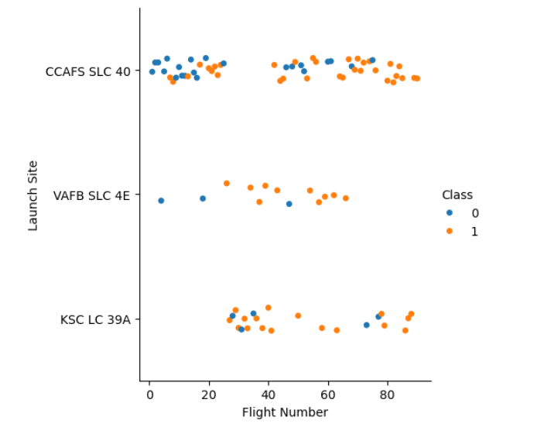
Flight Number vs. Launch Site
From the plot we found that the larger the flight amount at a launch site, the greater the success rate at a launch site

Slide 19
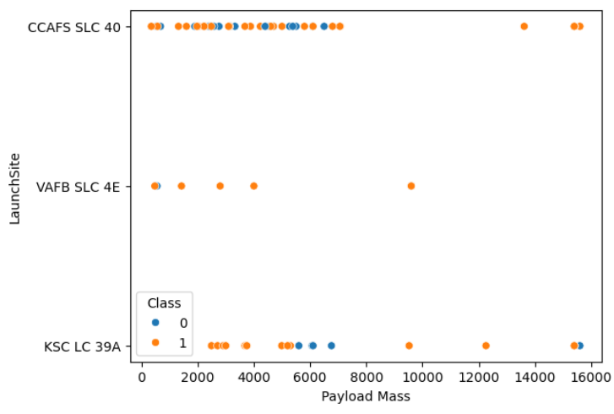
Payload vs. Launch Site
If you observe Payload Mass Vs. Launch Site scatter point chart you will find for the VAFB-SLC launchsite there are no rockets launched for heavypayload mass(greater than 10000)

Slide 20
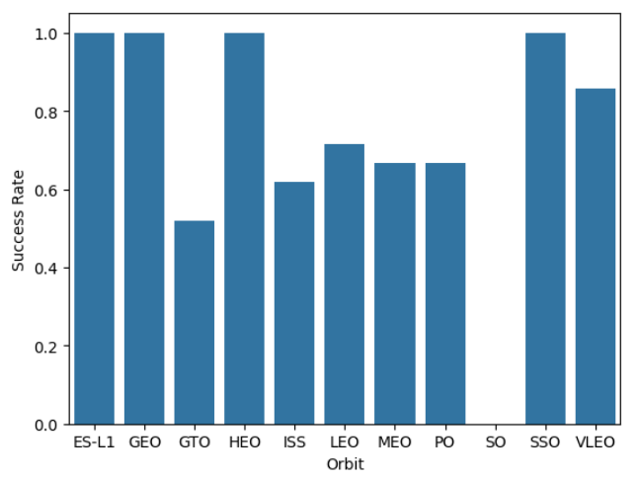
Success Rate vs. Orbit Type
SO Orbit have no success rate of first stage landing
ES-L1, SSO, HEO & GEO orbits have no failed first stage landing

Slide 21
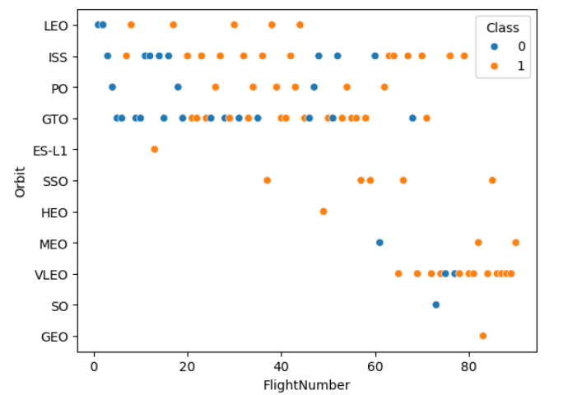
Flight Number vs. Orbit Type
There is a correlation between flight number and success rate with larger flight numbers being associated with higher success rates.

Slide 22
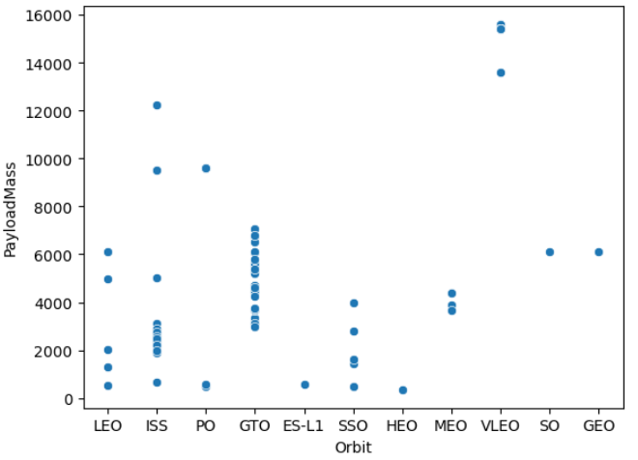
Payload vs. Orbit Type
Some orbit types have better success rates than others
Success rate appears to have obvious correlation with payload mass

Slide 23
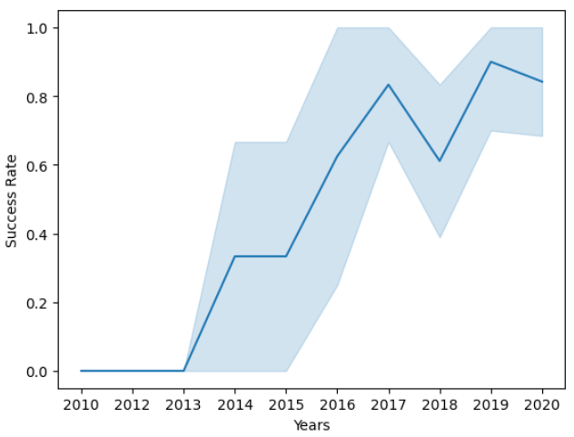
Launch Success Yearly Trend
The success rate has increased significantly over the years.

Slide 24
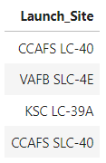
All Launch Site Names
Used DISTINCT keyword to get all unique launch sites from the SpaceX data
We found out that there are total 4 unique launch sites in SpaceX data

Slide 25
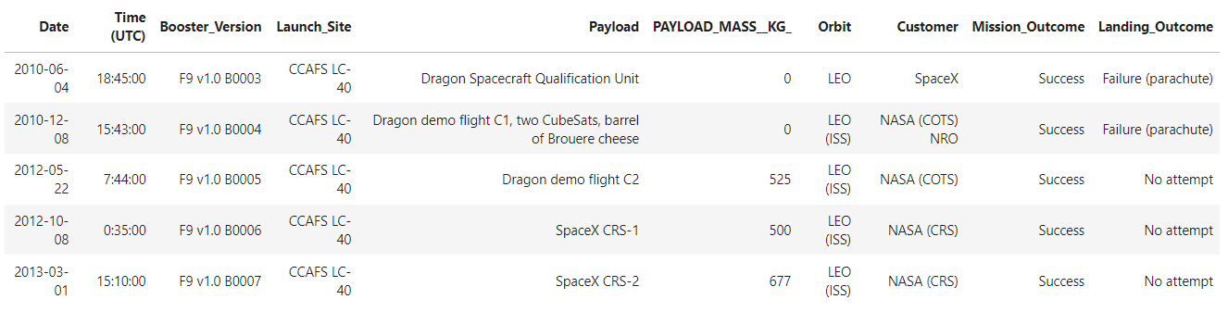
Launch Site Names Begin with 'CCA'
Top 5 records with CCA are
We used Where and Like query to find launch sites record starting with CCA

Slide 26
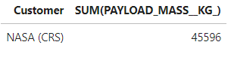
Total Payload Mass
The total payload carried by boosters from NASA is 48,213 kg.
We used sum function to find the Total Payload carried by boosters from NASA

Slide 27
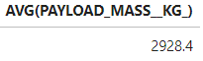
Average Payload Mass by F9 v1.1
The average payload mass carried by booster version F9 v1.1 is 2,928 kg
We used AVG() function to get average payload mass

Slide 28

First Successful Ground Landing Date
We observed that the dates of the first successful landing outcome on ground pad was 22nd December 2015

Slide 29
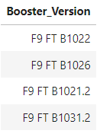
Successful Drone Ship Landing with Payload between 4000 and 6000
The four booster versions that have successfully landed on drone ship with a payload mass greater than 4,000 kg but less than 6,000 kg are listed right side.

Slide 30
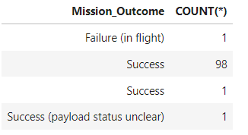
Total Number of Successful and Failure Mission Outcomes
Out of 101 mission there were 100 successful and 1 failed mission outcomes.

Slide 31
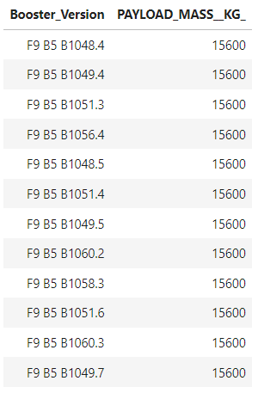
Boosters Carried Maximum Payload
The maximum payload mass carried in this dataset is 15,600 kg. Twelve (12) separate Falcon 9 boosters carried this amount of payload mass.

Slide 32
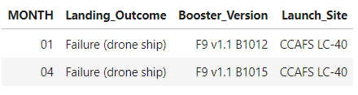
2015 Launch Records
There were two failed landing outcomes with a drone ship in 2015. Both launched from CCAFS LC-40. One occurred in January and the other in April

Slide 33
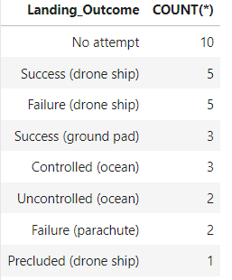
Rank Landing Outcomes Between 2010-06-04 and 2017-03-20
The most common landing outcome is ‘not attempted’
Drone ship landing outcome has 50-50% of success & failure

Slide 34

Section 3

Slide 35
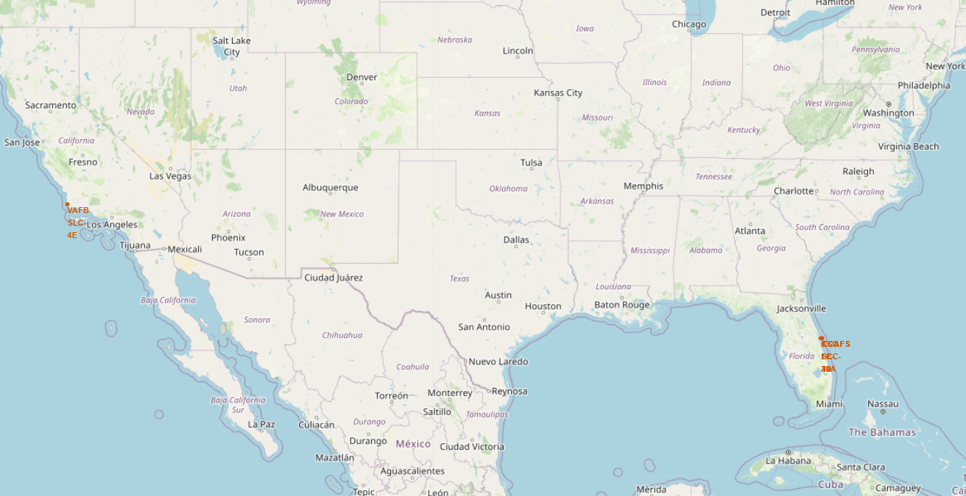
Launch Site Locations
We can see that the SpaceX launch sites are in United States of America at Florida & Los Angeles

Slide 36
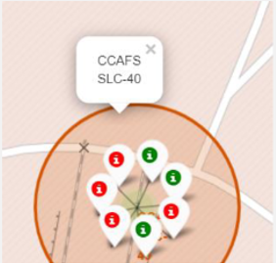
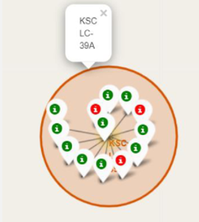
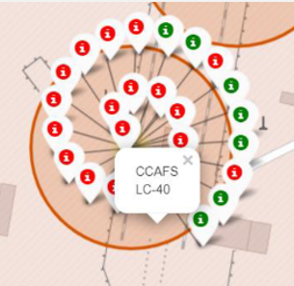
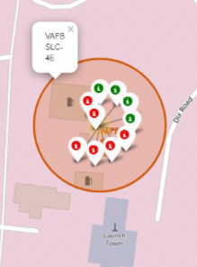
Map Markers of Success/Failed Landings
The markers display the mission outcomes (Success/Failure) for Falcon 9 first stage landings.

Slide 37
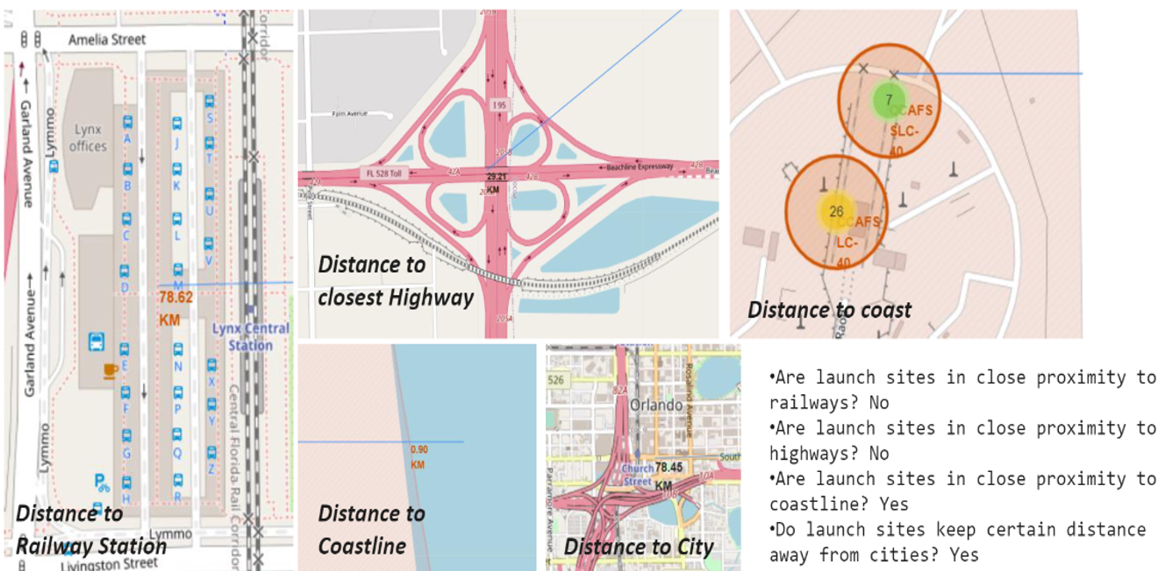
<Folium Map Screenshot 3>

Slide 38

Section 4

Slide 39
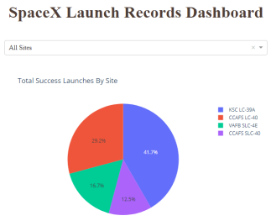
Success Rate of Launch Sites
The dropdown menu allows the selection of one or all launch sites
With all launch sites selected, the pie chart displays the distribution of successful Falcon 9 first stage landing outcomes between the different launch sites.

Slide 40
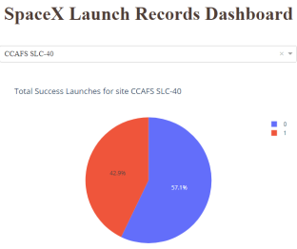
Launch Site With Highest Launch Success Ratio
CCAFS SLC-40 is the launch site with the highest Falcon 9 first stage landing success rate (42.9%)

Slide 41
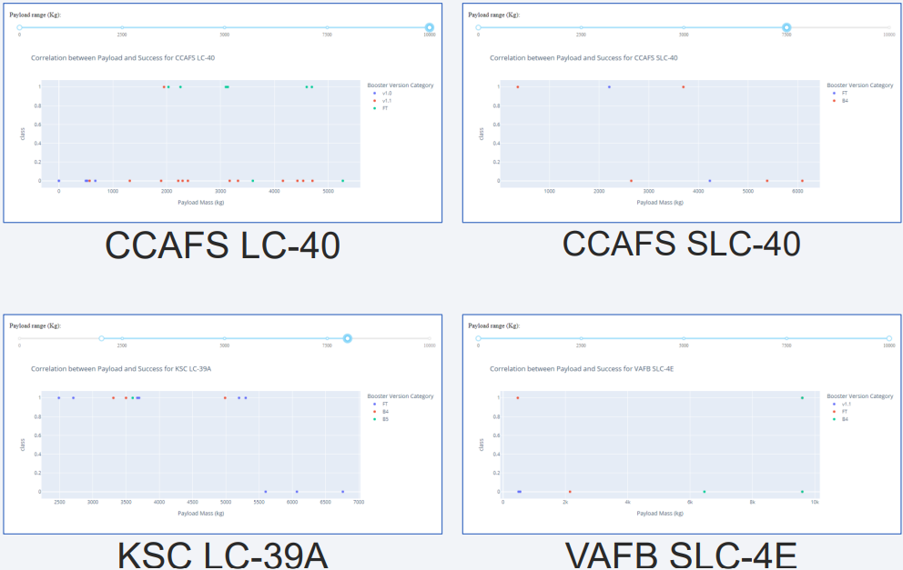
<Dashboard Screenshot 3>
The Payload vs. Launch Outcome scatter plots for all sites, with different payload selected in the range slider

Slide 42

Section 5

Slide 43
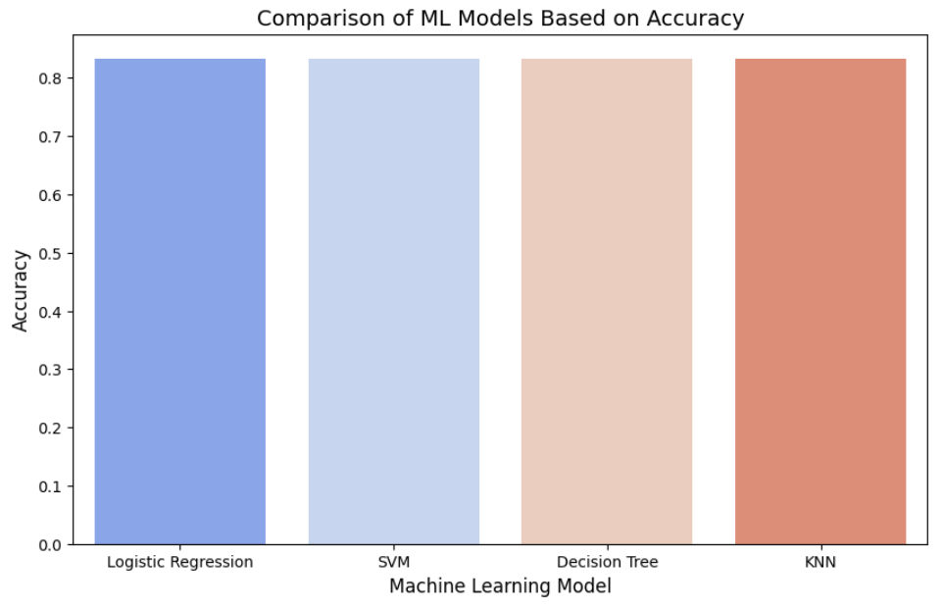
Classification Accuracy
Every ML Models accuracy is same that means they will perform almost same

Slide 44
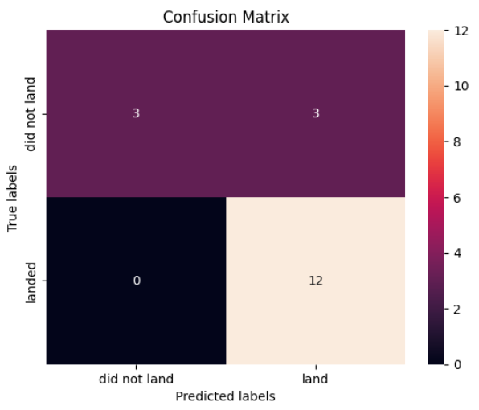
Confusion Matrix
The confusion matrix for the decision tree classifier shows that more than 80% of the prediction is correct

Slide 45
Conclusions
Launch success rate of falcon9 first stage landing is increasing over the years
The larger the flight amount at a launch site, the greater the success rate at a launch site
KSC LC-39A had the most successful launches of any sites
The machine learning models can be used to predict future SpaceX Falcon 9 first stage landing outcomes.

Slide 46
Appendix
Jupyter Notebook Used In This Project :-
GitHub URL (Data Collection): Click Here
GitHub URL (Web Scraping): Click Here
GitHub URL (Data Wrangling): Click Here
GitHub URL (EDA with SQL): Click Here
GitHub URL (EDA with Data Visualization): Click Here
GitHub URL (Folium Maps): Click Here
GitHub URL (Dashboad File): Click Here
GitHub URL (Machine Learning): Click Here

Slide 47


